Slide 1
Timekeeper
Brooke, Justin, Paula & Sai

Slide 2

What we built
A time tracker application for hourly work.
Keep up with projects and tasks, plus add a short description to note exactly what you are working on.
Generate excel sheet straight from Timekeeper.

Slide 3
Why we built timekeeper
Important tool for users who work from home.
Practical use and intuitive design.
Real world application
Tracks progress on projects and tasks

Slide 4
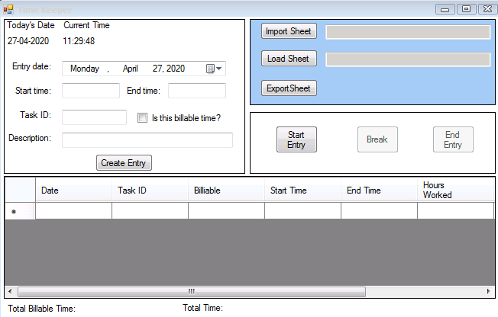
Our timekeeper

Slide 5
How it works
Demonstrate use.

